Slide 1
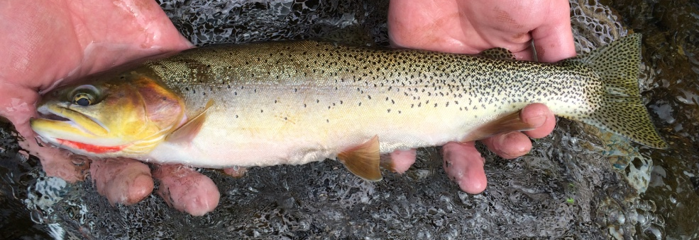
Headwater Stream Ecosystems
Zach Lessig

Slide 2

Why this study?
Stream metabolism incorporates information about all aerobic organisms and habitats.
Trout are the top predators in headwater streams and may indicate the functioning of lower trophic levels.

Slide 3
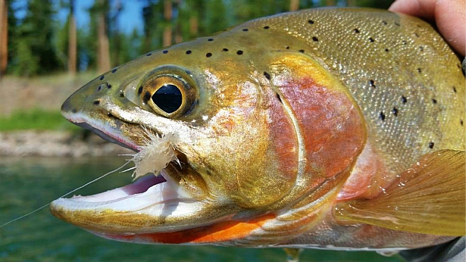
Why this study?
Objective:
Identify what headwater stream environmental variables best predict:
Ecosystem Respiration (ER)
Gross Primary Production (GPP)
Trout biomass.

Slide 4
Some terms…
Gross Primary Production (GPP) – this is the phototrophic synthesis of organic compounds using light and CO₂ which produces O₂.
Ecosystem Respiration (ER) – this is the release of CO₂ through metabolism by autotrophic and heterotrophic organisms which consumes O₂.
Trout Biomass – this is the estimated mass of all trout per stream reach.

Slide 5
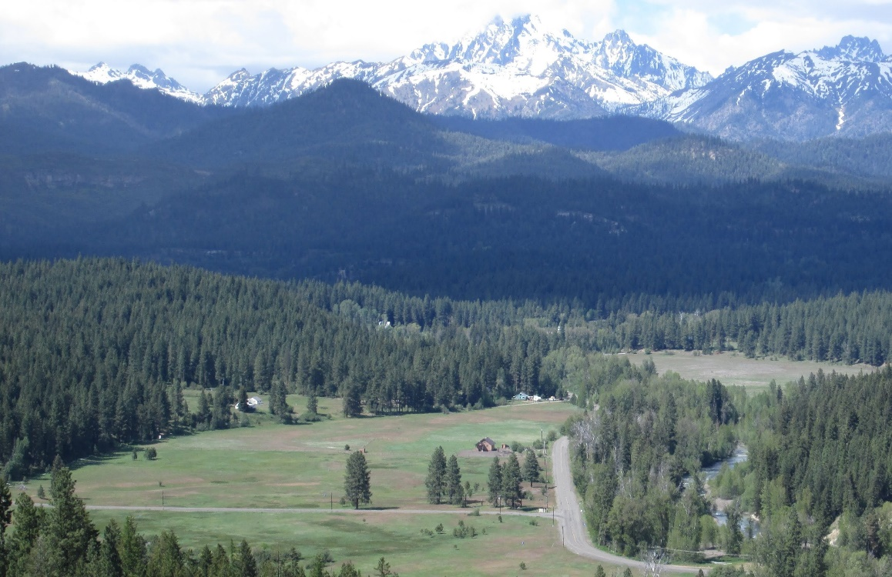
Basin
Swauk
Swauk
Iron
Blue
Hurley
Hovey
Teanaway
Miller
Jack
Standup
Taneum
First
Frost
Time of Sampling
Summer 2017
Fall 2017
Summer 2018

Slide 6
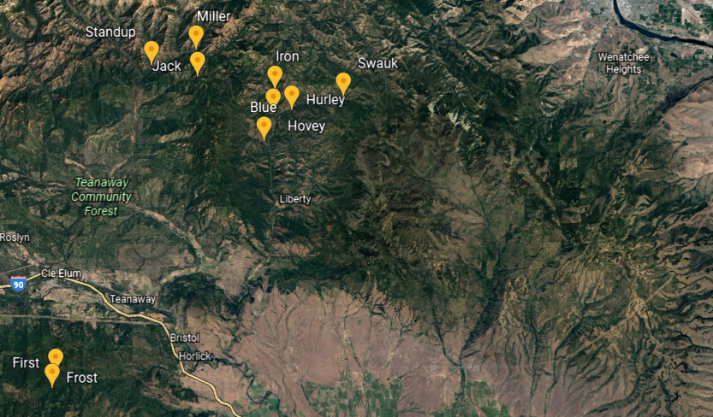

Slide 7
Data Collected
Elevation (m)
Aspect (º)
Slope (%)
Bank Full (m)
Pebble Median (mm)
Wetted Width (m)
Depth (m)
Discharge (L/s)
Canopy (% open)
Carbon (C) (DOC mg C/L)
Nitrogen (N) (DIN mg N/L)
Phosphorus (P) (SRP mg P/L)
Photosynthetically Active Radiation (PAR) (µmol photons/m²/s)
Water Temperature (ºC)
Dissolved Oxygen (DO) (mg/L)
Cutthroat Biomass (g/m of stream)
Gross Primary Production (GPP) (g O₂/m²/d)
Ecosystem Respiration (ER) (g O₂/m²/d)

Slide 8
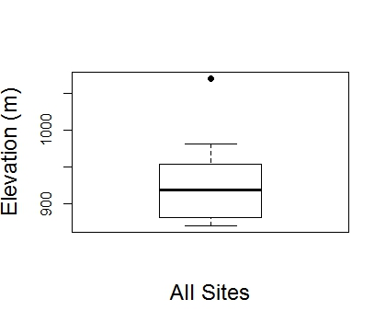
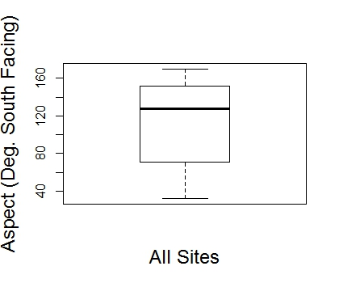
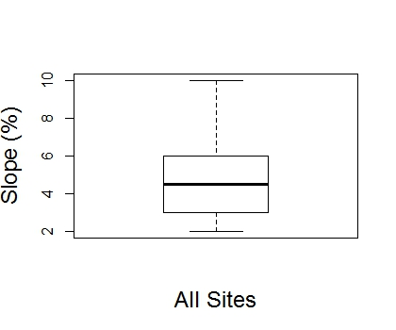
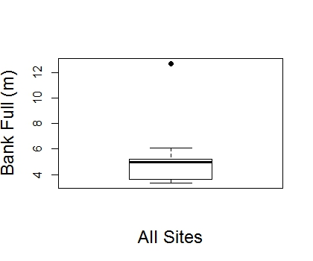
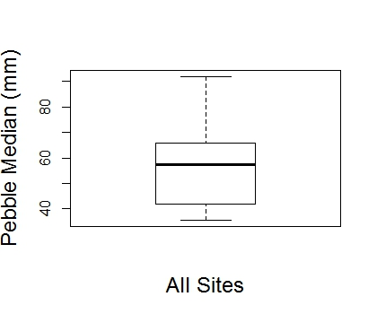

Slide 9
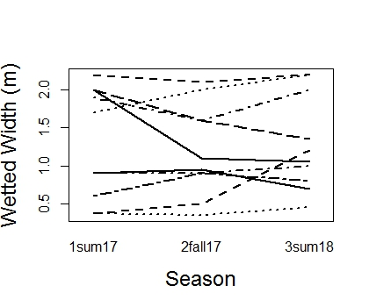
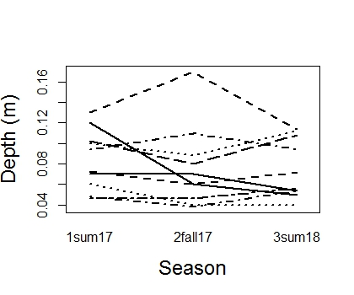
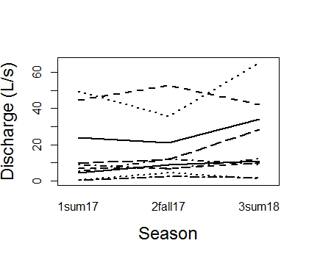
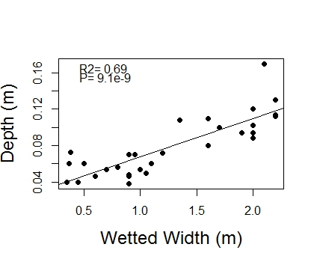
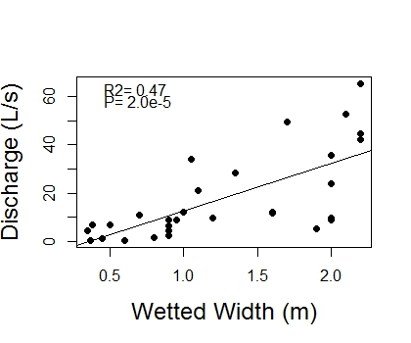
A
A
A
A
A
A
A
A
A

Slide 10
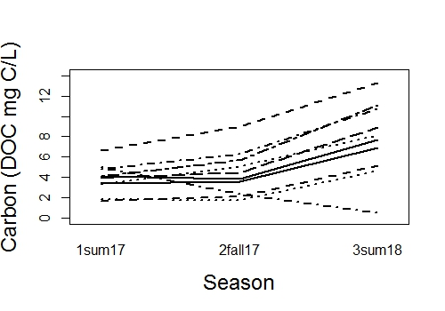
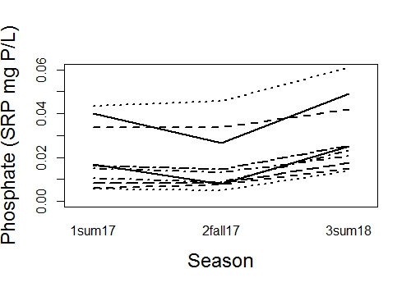
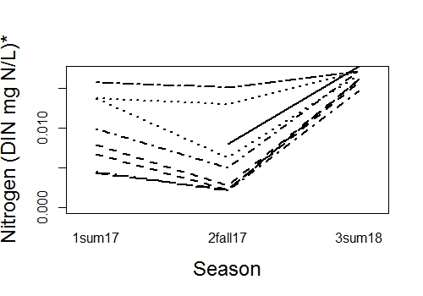
B
B
A
B
B
A
B
B
A

Slide 11
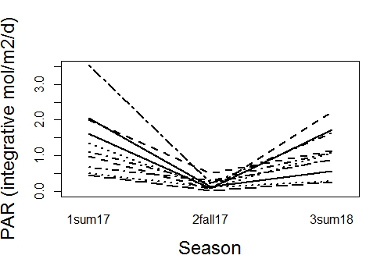
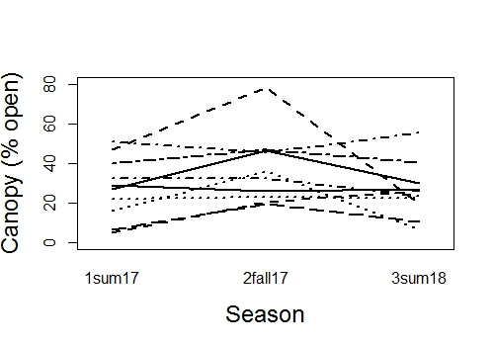
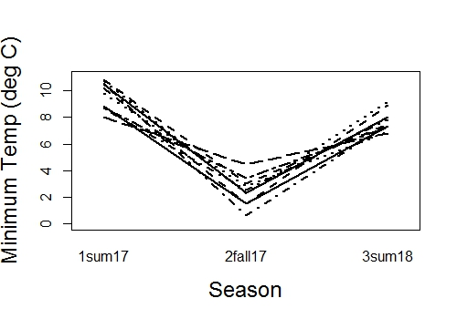
A
B
A
A
A
A
A
C
B

Slide 12
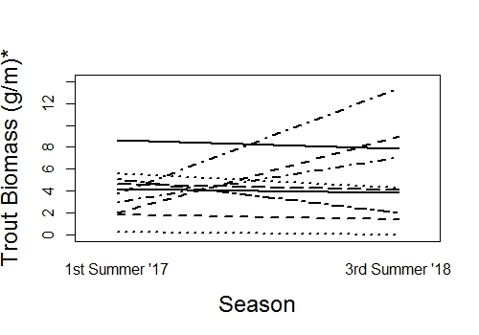
A
A

Slide 13
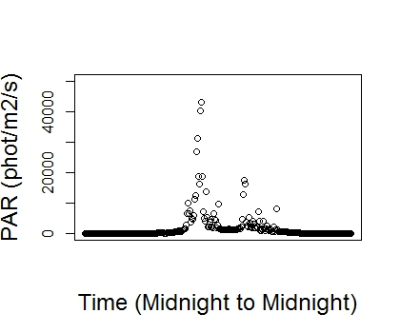
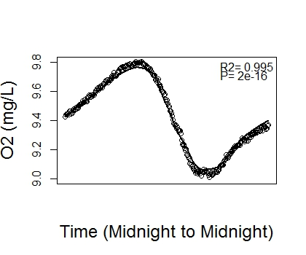
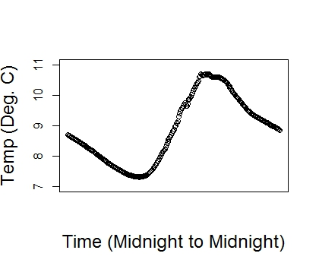
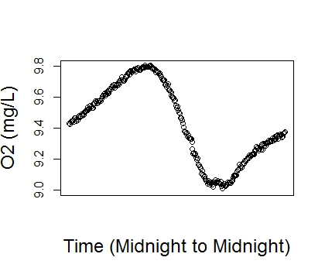
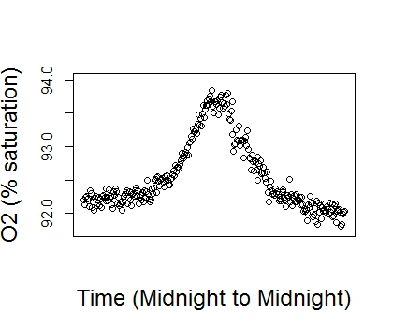
One station metabolism method using inverse modeling
Use this data to estimate:
Gas Exchange Constant (K600)
GPP
ER

Slide 14
Choosing a model to estimate metabolism
Use 1 model
Use 2 models
Run a model that estimates K600, GPP and ER
This method may risk an over-paramaterized model
This method produced less believable values
Derive K600 and use that for estimating GPP and ER
Run a “Nighttime Regression Model” that estimates K600
Derive K600 equation using “good” model output from the 1 model method
Derive K600 equation from literature data

Slide 15
Choosing a model to estimate metabolism
My Model for K600
Literature derived K600
Run models that estimate K600
Use “good” models to derive K600 where:
0<GPP
0>ER
0<K600
95<R2
Ln(K600)=1.6703*ln(Velocity)+3.2482
R2=0.27, P=0.07
Derive equation for K600 based on Hall (2018) to use in models
Ln(K600)=0.9557*ln(Slope)+3.0667
R2=0.68, P=0.01

Slide 16
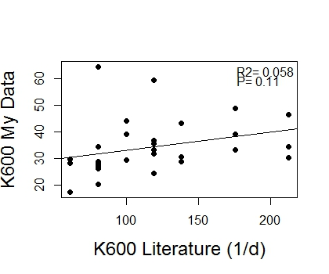
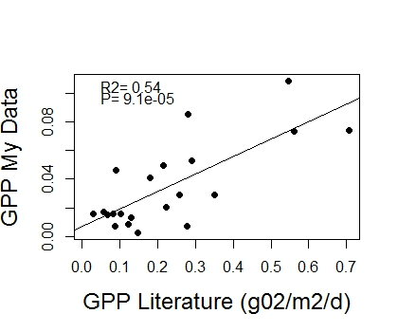
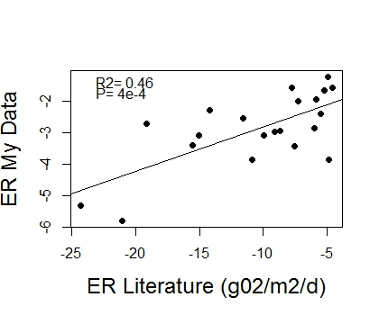
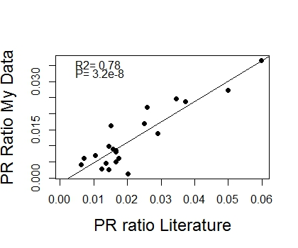
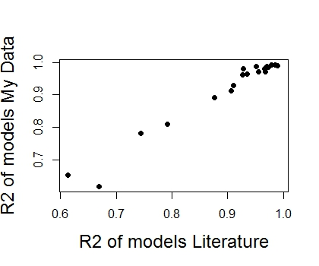
I chose the Literature derived equation

Slide 17
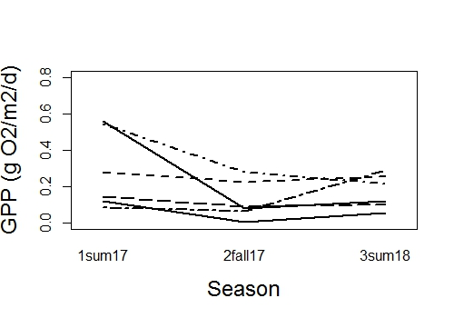
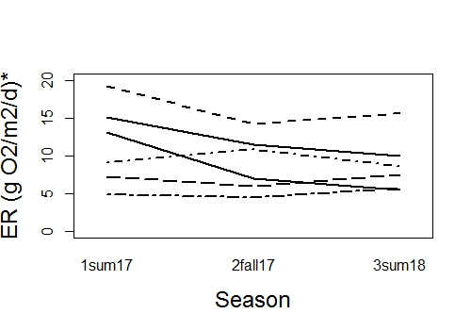
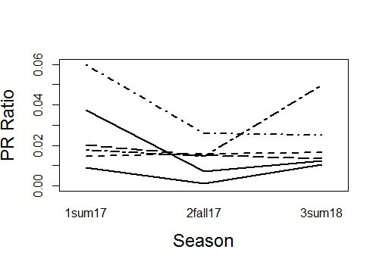
B
B
A
A
B
AB
A
A
A

Slide 18
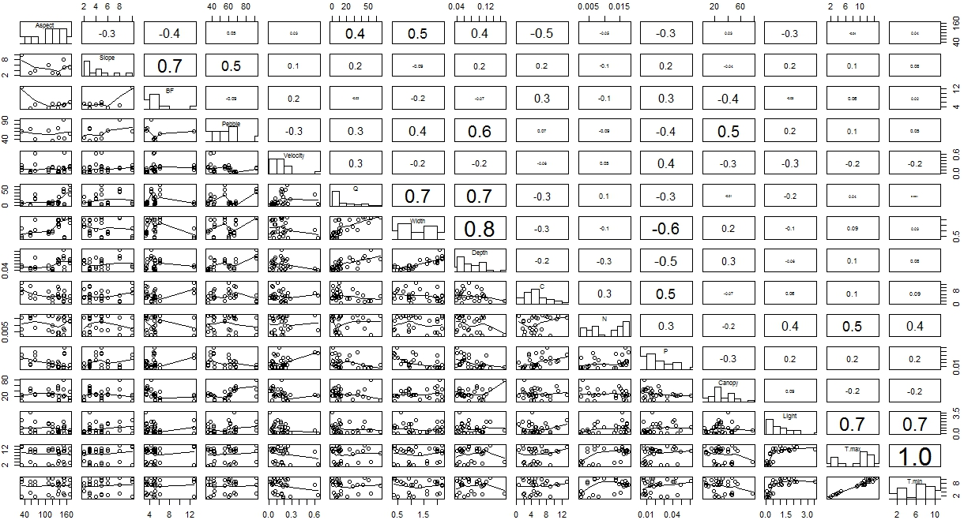

Slide 19
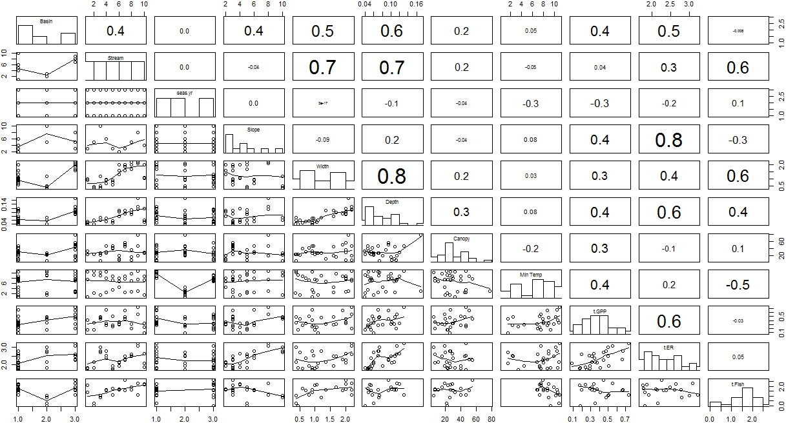

Slide 20
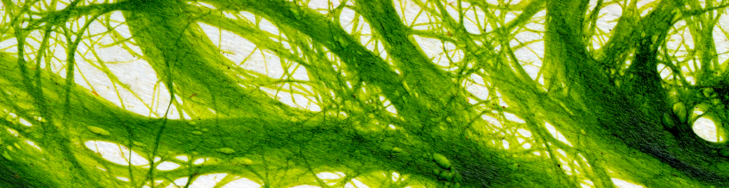
GPP model
Lme (Transformed GPP ~ season.yr + Depth)
log(1+GPP)^(1/2)
random = ~1|stream
varIdent(form = ~1|stream)

Slide 21
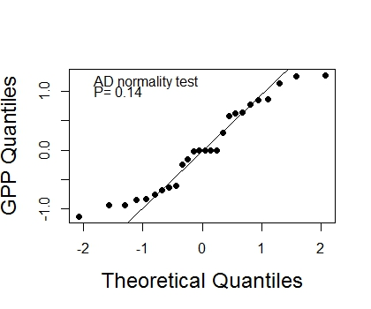
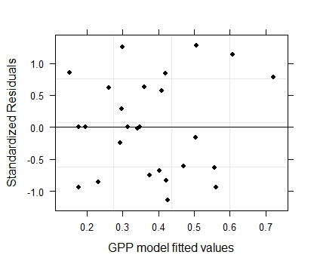
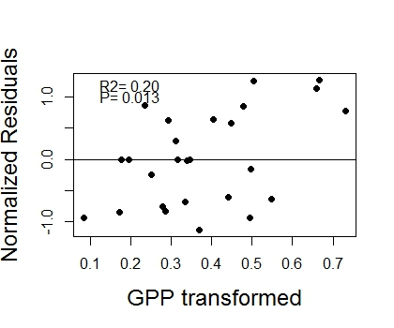
GPP Model Validation

Slide 22
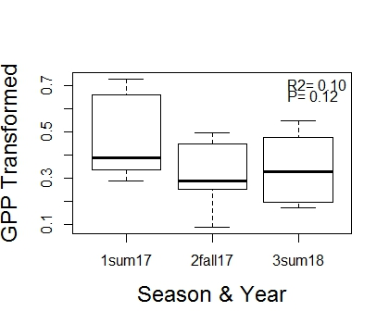
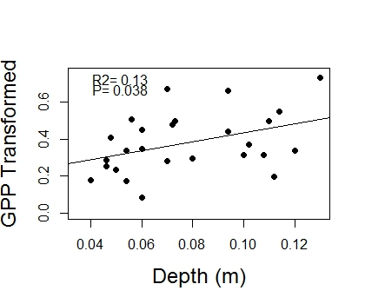
GPP Model Interpretation

Slide 23
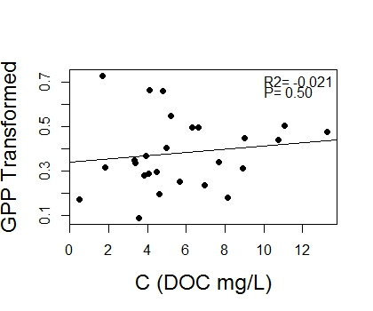
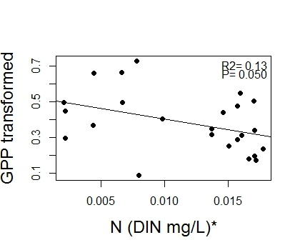
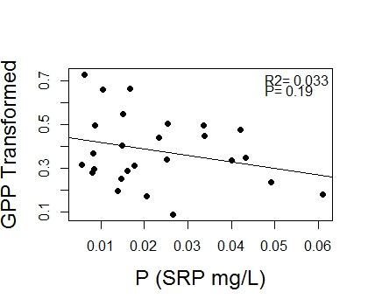
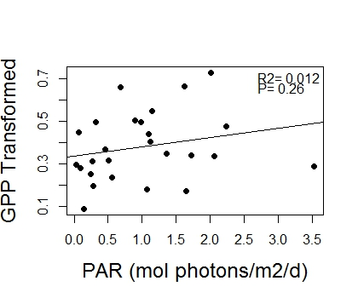
GPP Non-Model Graphs

Slide 24
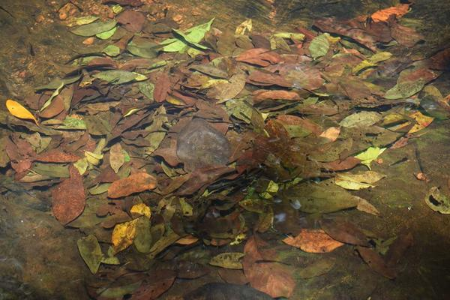
ER Model
Lme (Transformed ER ~ Depth + Slope)
log(1+|ER|)
random = ~1|stream
method=ML

Slide 25
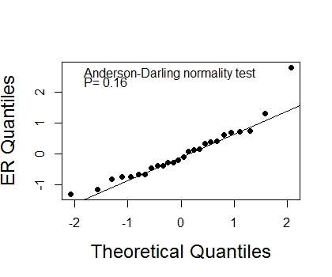
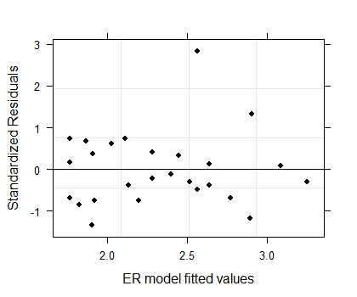
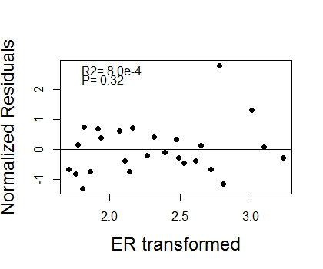
ER Model Validation

Slide 26


ER Model Interpretation

Slide 27




ER Non-Model Graphs

Slide 28

Trout Biomass Model
gls(Transformed Trout Biomass ~ Basin + Width + Min Temp*Canopy Openness)
log(1+Trout Biomass)
varExp(form = ~fitted(.))

Slide 29



Trout Model Validation

Slide 30




Trout Model Interpretation

Slide 31




Trout Non-Model Graphs

Slide 32




Other Considerations…

Slide 33

Questions?

